Slide 1
Information Visualisation
Milestone 1
Team:
Arthur Tay
Kah Wai
Kennard Ko

Slide 2
Agenda
Data - Visualization 1
Task - Visualization 1
Idiom - Visualization 1
Critique - Visualization 1
Improvement - Visualization 1
Data - Visualization 2
Task - Visualization 2
Idiom - Visualization 2
Critique - Visualization 2
Improvement - Visualization 2

Slide 3
Visualization 1

Slide 4
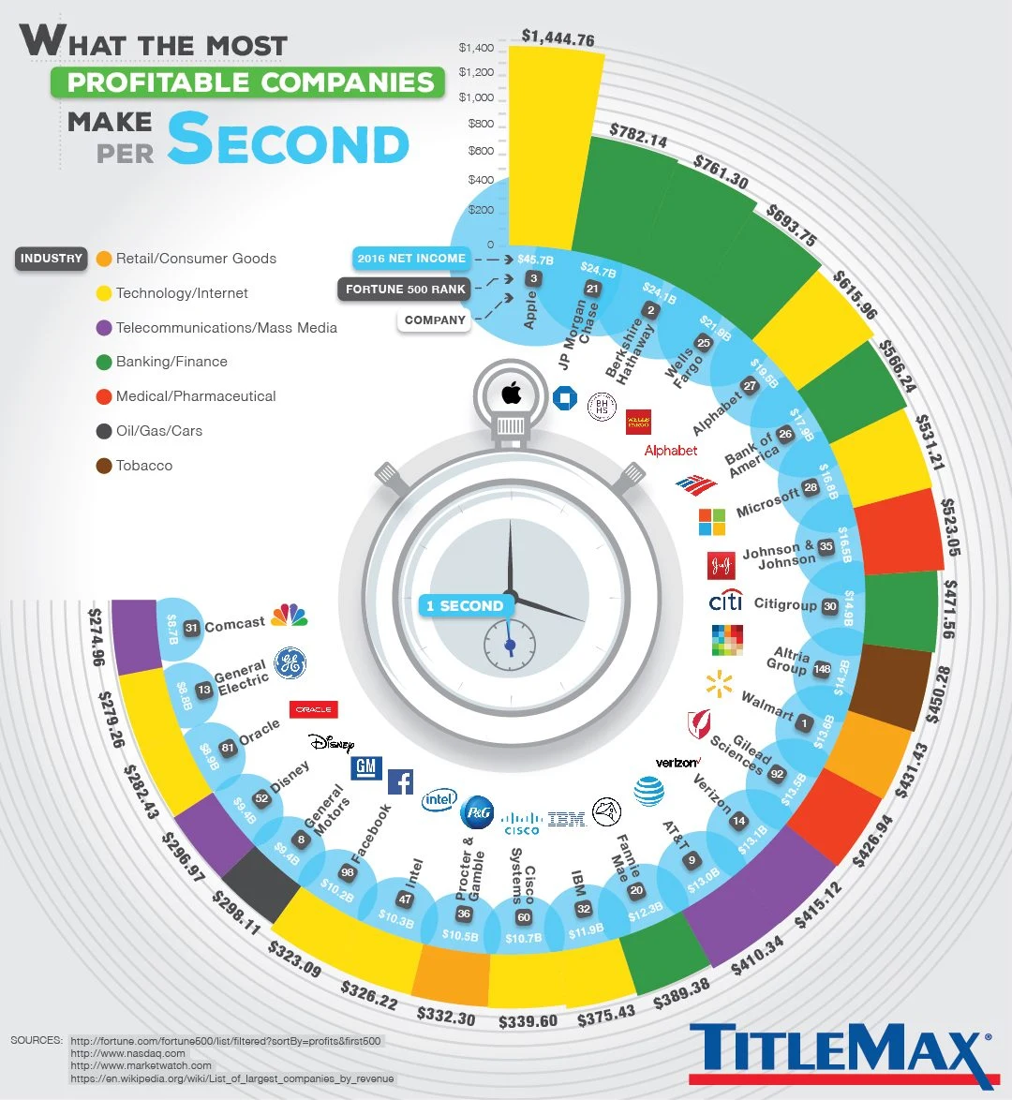
Data (What)
Items
Tabular information
Attributes
Company
Net Income
Profit
Data Scales
Nominal: Company, Industry
Ordinal: Fortune 500 Rank
Ratio: Net Income, Profit
Static Availability
No data hierarchy
Industry
Fortune 500 Rank

Slide 5
Task (Why)
Analyze
Exploratory
Consume
Present most profitable companies
Discover additional information
Produce: Annotation
Search
Browse
Target Unknown: Profit
Location Known: Company
Query
Identify top profitable companies
Compare various data between each other
Target
Analyze Features
Data correlation
Many Attributes
Notes:
Discover additional information e.g. Most profitable industry
Identify - Top profitable companies with various information such as industry, net income and fortune 500 rank

Slide 6
Idiom (How)
Encode (Bar Chart)
Express
Y-axis: Profit per second
X-axis: Company
Size (Height) of bars - Profit per second
Color - Hue (Industry)
Order - Clockwise ranking based on profit per second
Align - Radial alignment
Separate
Company icon
Fortune 500 ranking
2016 Net Income

Slide 7
Critique
Accuracy
Bad readability
Radial shape alignment
Tilted data labels
Discriminability
Attribute data
Separability
Same color bars - Hard to differentiate
Net Income text (white) on light blue background makes it difficult to read
Grouping
Proximity of bars are too close which makes it difficult to differentiate
Expressiveness
X and Y axis are not labelled clearly and axis values are small
Fortune 500 ranking is confusing with the order of profit per second
Num of data points
Notes:
X axis contains 3 attribute data, not sure which is the x axis
Fortune 500 ranking is confusing with the order of profit per second e.g. Apple is the most profitable company which is the first on the chart but is 3rd on fortune 500

Slide 8
Improvement
Accuracy
Position data on a straight line
Horizontal data labels
Discriminability
Separate into multiple different charts
Reduce data points
Separability
Border strokes for bars
Ensure text is easily readable (Size & Color)
Grouping
Include sufficient white space between data
Miscellaneous
Include X and Y axis labels
Ensure axis values are readable
Notes:
Separate into multiple different charts to represent different attribute data
Reduce data points for better understanding of the visualization
Border strokes for bars to differentiate each data point better
Include sufficient white space between data e.g. the bars to differentiate

Slide 9
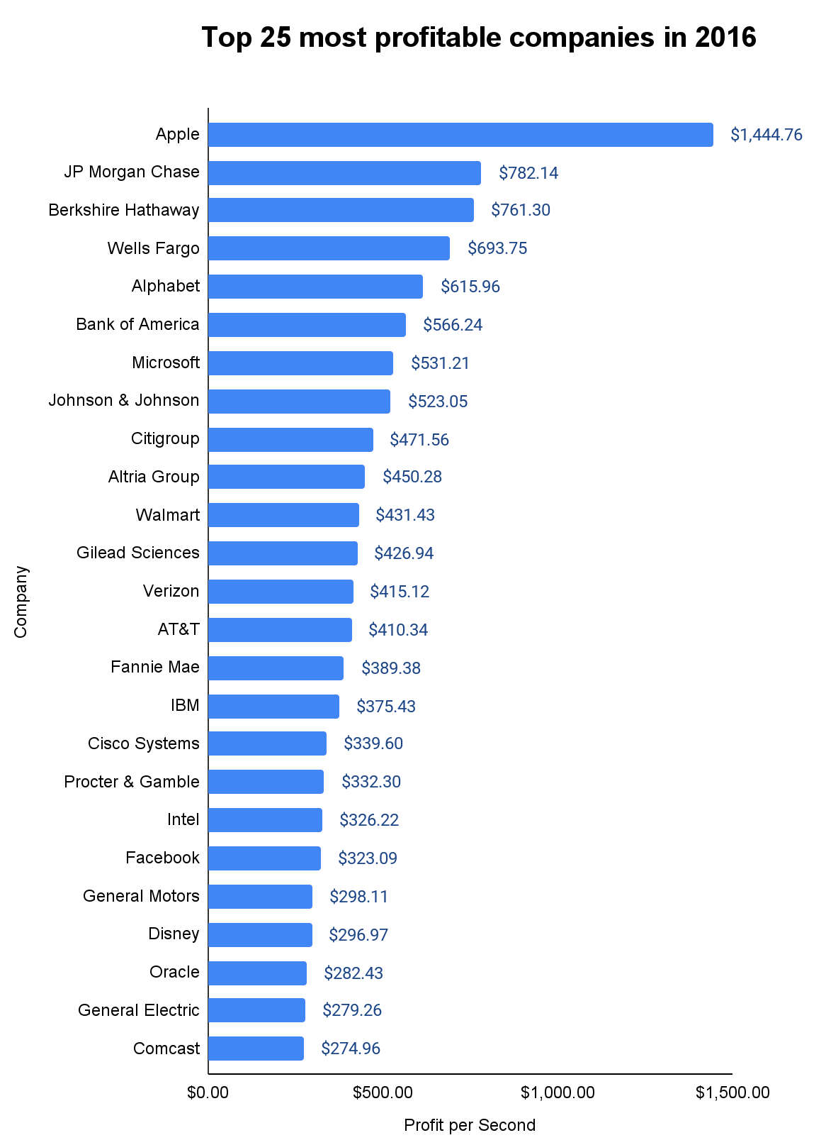
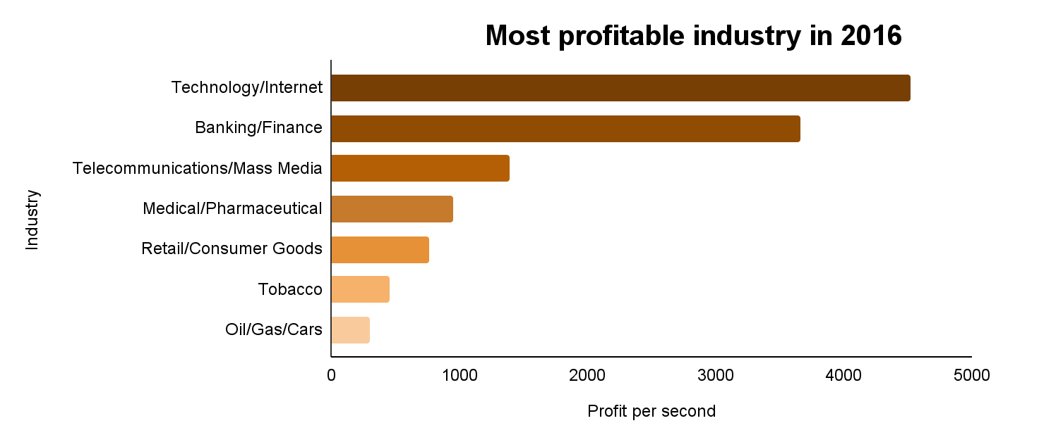
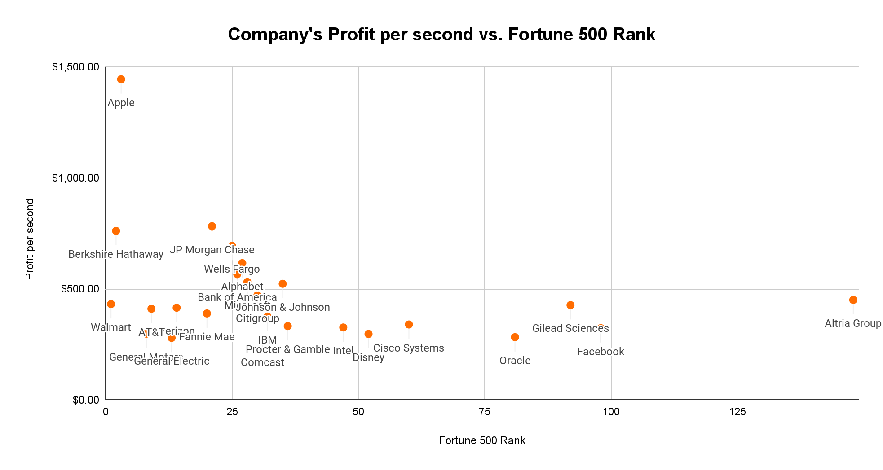
Notes:
Scatter plot to add color scheme for industry type

Slide 10
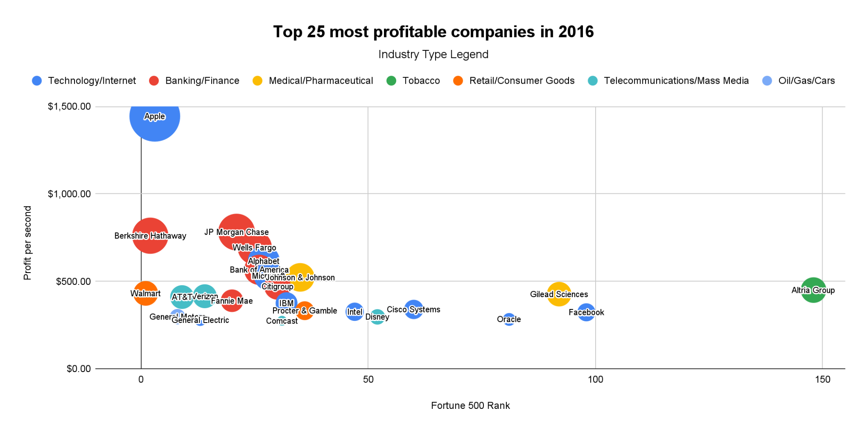
Notes:
Replace text with company logos into the bubble
Color scheme - industry
Size of bubble is net income
Data correlation with profit per second and fortune 500 rank

Slide 11
Visualization 2

Slide 12
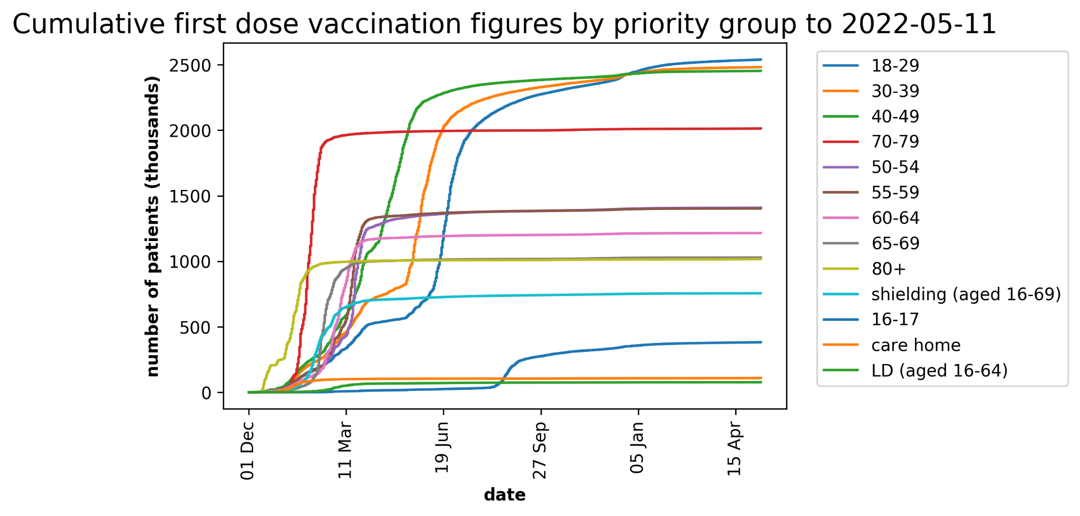
Data (What)
Items
Tabular information
Number of people vaccinated for each age range and group
Attributes
Covid Vaccination Date
Total Vaccinated
Age Range (9 Columns)
Data Scales
Ordinal: Vaccination Date
Ratio: Vaccinated patients for total and each age group
Static Availability
No data hierarchy
Shielding
Care home
LD

Slide 13
Task (Why)
Analyze
Exploratory
Consume
Discover additional information i.e. the number of vaccinated patient for each age group
Produce: Annotation with age group
Search
Browse
Target Unknown: Vaccination Rate
Location Known: Age Group
Query
Identify : Number of vaccinated patients
Compare: Age group value
Summarize: Time taken for each age group to complete first dose vaccination
Target
Completion of age group vaccination
Monitor similar age group

Slide 14
Idiom (How)
Encode (Line Chart)
Express
Y-axis: Number of Vaccinated Patient
X-axis: Date of Vaccination
Size (Height) - Number of people
Color - Hue (Age group)
Order - Cumulative vaccinated patient over time
Separate
Age Group
Date

Slide 15
Critique
Accuracy
Linechart accurately shows quick sense of how things changes over time
Bad readability
Overlapping of lines category
Vertical data label
Discriminability
Hard to discriminate - too many age group
Grouping
Similarity - Some of the colors used are similar but are different categorical groups; making it hard to differentiate
Continuity - Continuous path over time
Expressiveness
X-axis date is inconsistent with sporadic interval jumps
Legend unsorted with no order and includes categorical labels (eg. care home)

Slide 16
Improvement
Accuracy
Linestack chart to show each group value
Discriminability
Separate into multiple different line charts
Separability
Ensure text is easily readable and colours used are distinct (Size & Color)
Miscellaneous
Ensure axis values are readable and change the x-axis label with start of the month
Include tooltips when hovering on the visualization
Sort the age group interval values in ascending order
Notes:
Separate into multiple different charts to represent different attribute data
Reduce data points for better understanding of the visualization
Border strokes for bars to differentiate each data point better
Include sufficient white space between data e.g. the bars to differentiate

Slide 17
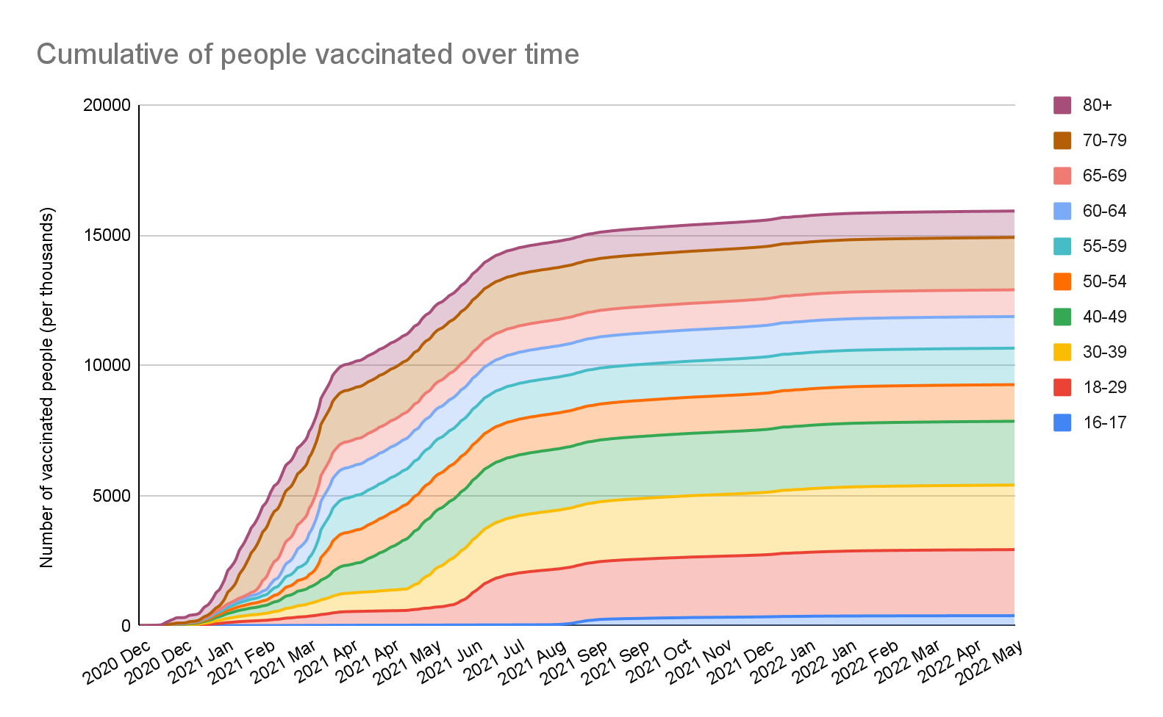
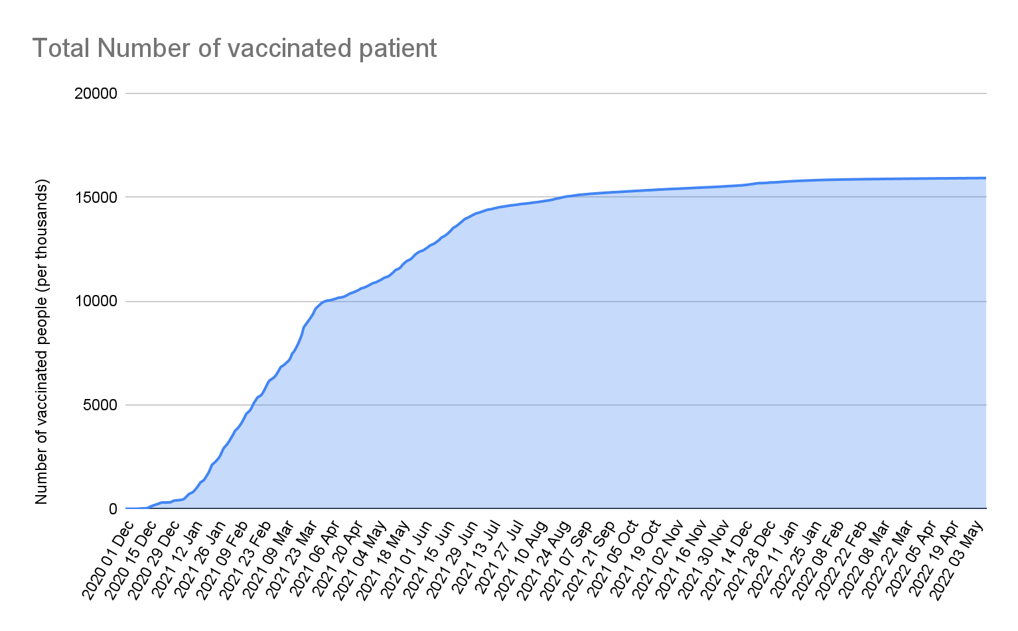
Dec-20 Jan-21 Feb-21 Mar-21 Apr-21 May-21 Jun-21 Jul-21 Aug-21
Dec-20 Jan-21 Feb-21 Mar-21 Apr-21 May-21 Jun-21 Jul-21 Aug-21

Slide 18
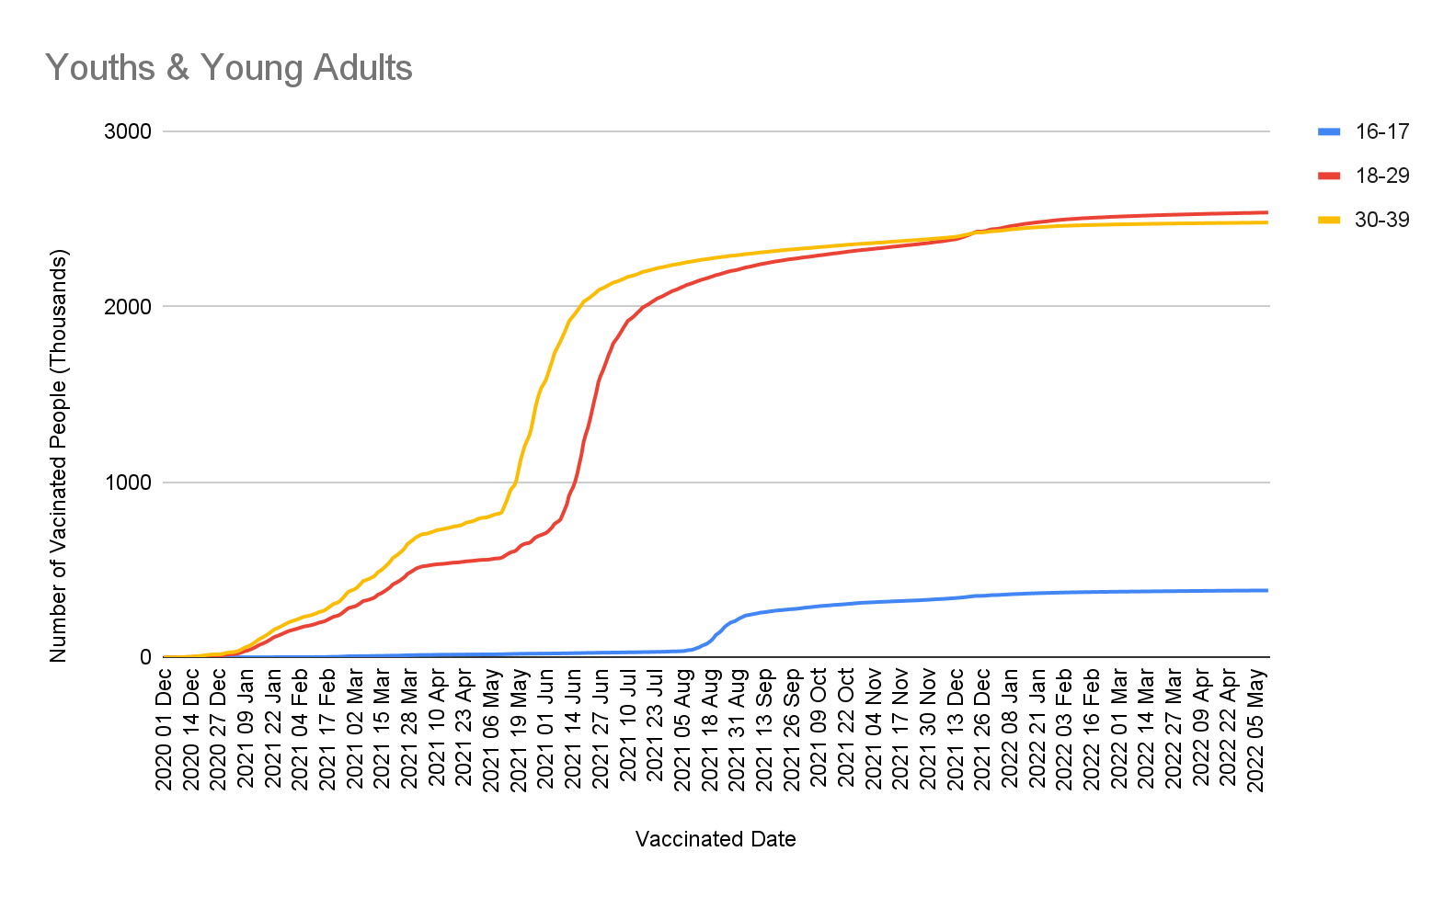
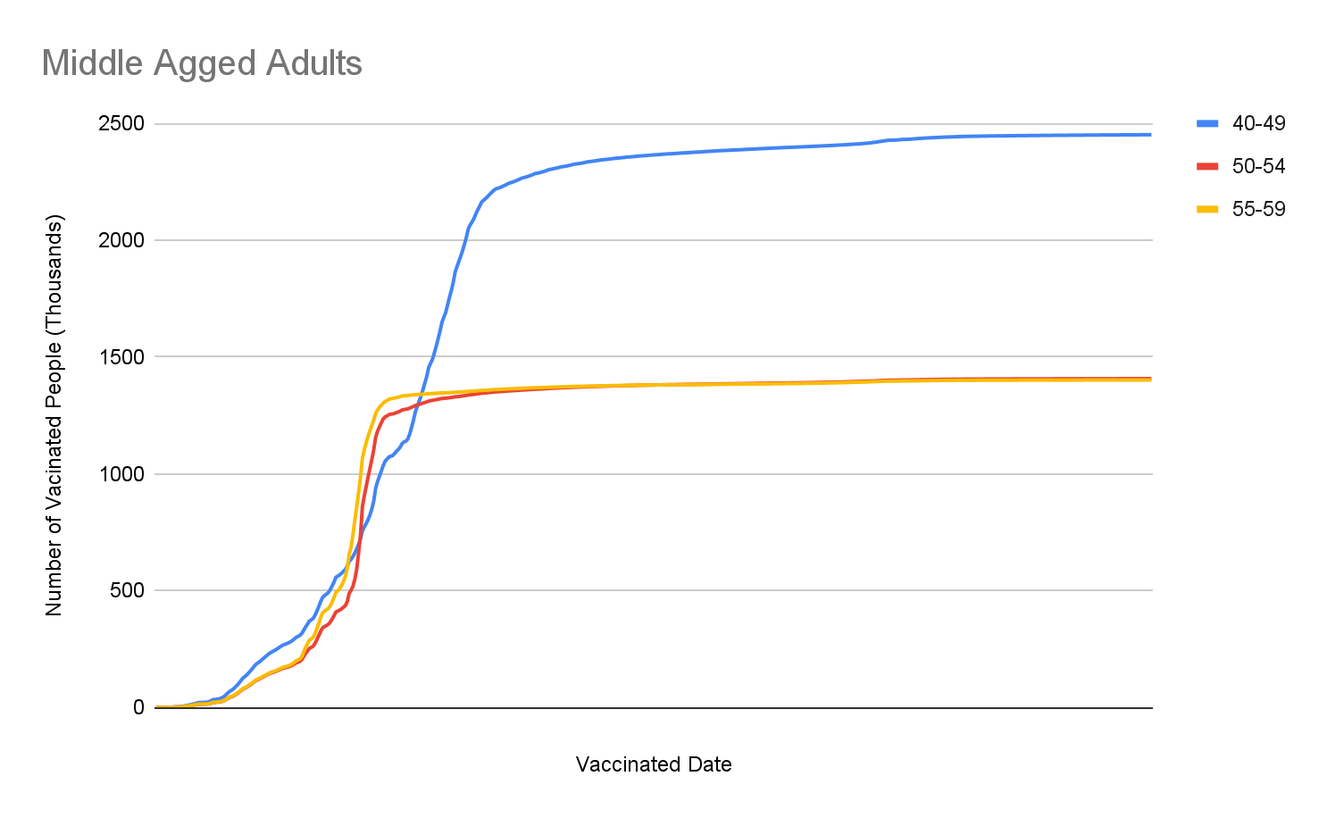
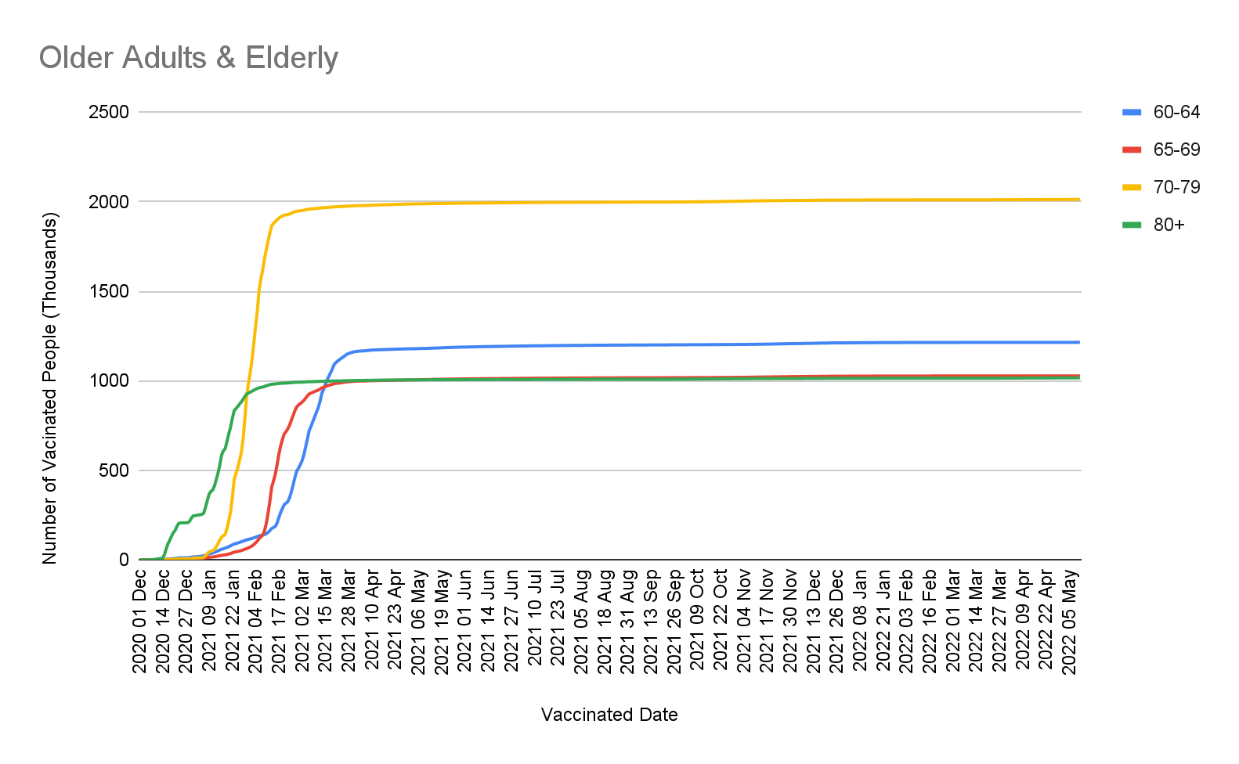
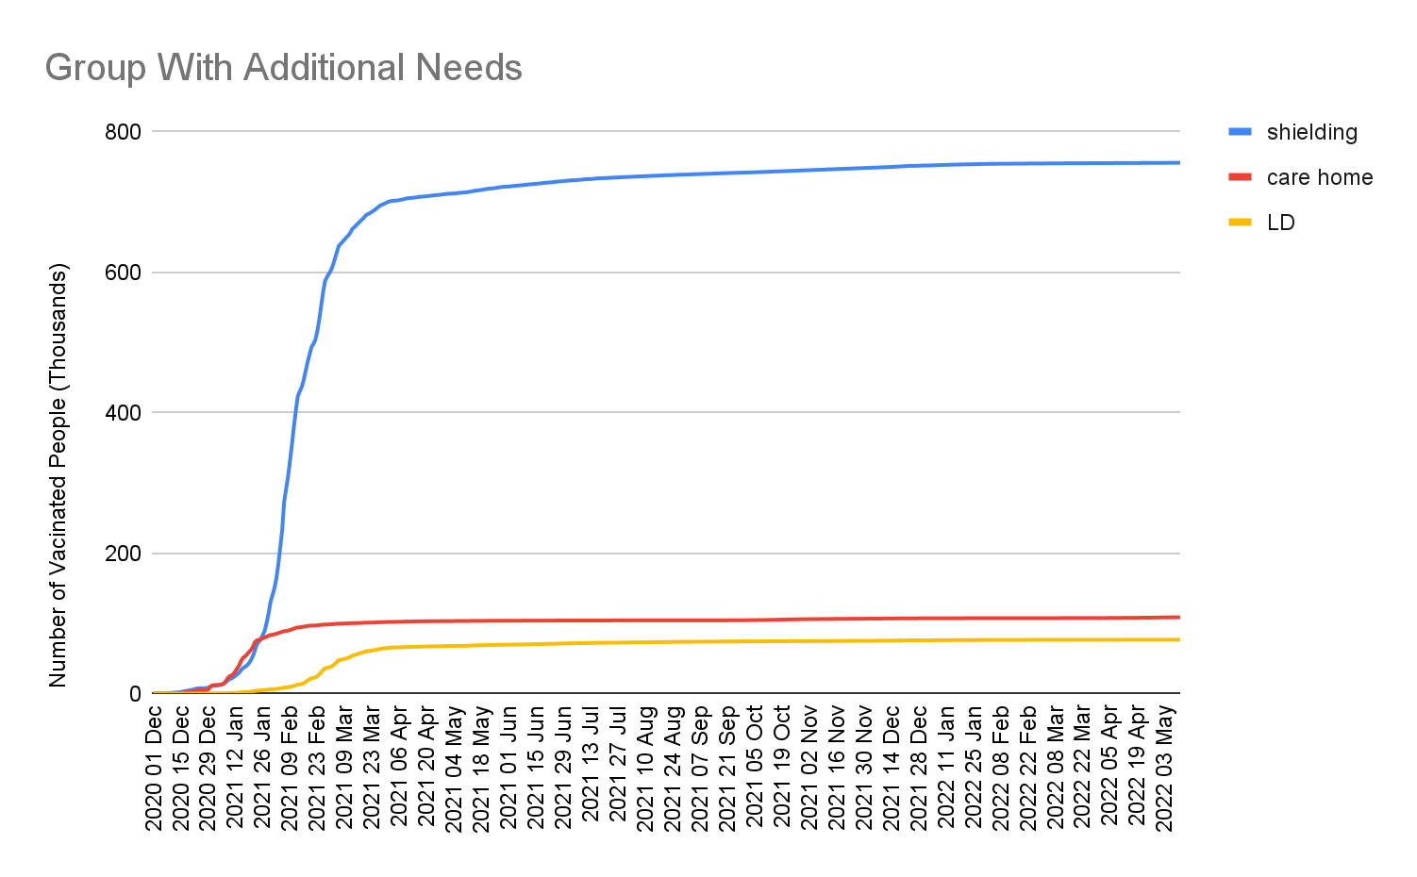
Dec-20 Jan-21 Feb-21 Mar-21 Apr-21 May-21 Jun-21 Jul-21
Dec-20 Jan-21 Feb-21 Mar-21 Apr-21 May-21 Jun-21 Jul-21
Dec-20 Jan-21 Feb-21 Mar-21 Apr-21 May-21 Jun-21 Jul-21
Dec-20 Jan-21 Feb-21 Mar-21 Apr-21 May-21 Jun-21 Jul-21

Slide 19
Q & A

Slide 20
Thank you for your time

